Slide 1
C.Difficile Improvement Work
Sue Valentine, RN, Infection Prevention Coordinator
Harrington Hospital
100 South Street, Southbridge, MA 01550
Notes:
I am Sue Valentine, and like the others here, I have been personally affected by C. Diff, but in a different way. I am the infection control coordinator at Harrington Hospital, where I have been for more than 4 years. I have been shocked at the virulence of the NAP-1 strain of C. Diff, and have put into place many changes that have helped reduce the hospital’s incidence of C. Diff.

Slide 2
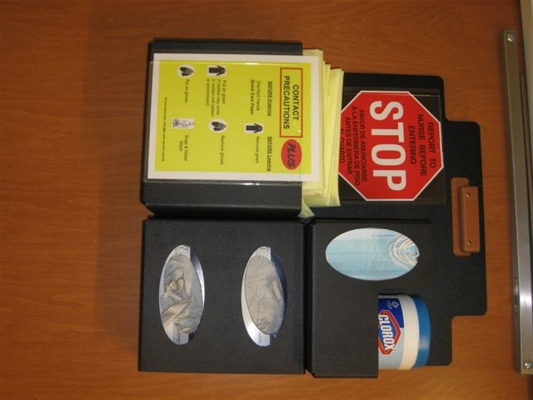
Harrington’s Story
6/2009
C. diff policy approval incorporating “Contact Precaution Plus”
Unit specific education to all clinical units and ancillary departments
Notes:
You didn’t know you were going to need tissues, did you?
Harrington started looking at C. diff early on. Early June we had PPE on doors, we met with housekeeping in terms of why it was so important, we talked about why it is important to clean etc.

Slide 3
TURNING POINT # 1
1/2010 Mr. Beaudy’s admission
2/2010 RCA completed
Lessons learned:
We needed to wage a PR campaign to “redefine” C. diff
and the new NAP1 strain
We needed to expand our focus to include early identification and treatment not just prevention
We needed to expand our educational focus to include the providers and the community
Notes:
However, we approached a turning point in the end of December 2009, when we readmitted Ann’s father in law Mr. Beaudry. We were all devastated by what happened. In February we completed a root cause analysis, and found that even though we had worked so hard in educating our staff, we discovered that we actually missed an entire piece, which was early identification and treatment.

Slide 4
ACTIONS
Revised IP Plan and RA to include C. diff
as new goal # 5
“To decrease the number of HA C. diff cases and early identification and treatment of C. diff.”

Slide 5
EDUCATION- STAFF
Had educated staff but needed to focus on the new more toxic strains. It was a public relations campaign!
3/2010 Screen saver on C. diff
3/2010 Healthlines- Harrington Newsletter
4/2010 Mandatory C. diff education
Notes:
We had rolled out the red carpet, but hadn’t put enough emphasis on the newest strain. Everyone was comfortable with not using

Slide 6
EDUCATION- PROVIDERS
3/2010 C. diff Policy update to include treatment guidelines
4/2010 Meeting with Providers on new guidelines, Contact Precautions Plus, risk factors
Treatment Guidelines posted
6/2010 CME lecture - “C. diff Colitis”
Dr. Michael Gaudet– Infectious Disease
9/2010 CME lecture – “C. diff Colitis”
Dr.Nam Kim – Umass Medical Center
Notes:
We also realized that we hadn’t done very much with educating the prodivers. We had our uinfectious disease specialist, Dr. Gaudet

Slide 7
REPORTING & TESTING
3/2010 Included more specific language regarding specimen collection in policy
Laboratory calls positive results to floor
CTOX testing became Nursing Initiative
Notes:
We looked at reporting and testing. We updated the policy to include more specific language about testing and reporting, and decided that the lab needs to call the floors with positive results. The nurses became empowered to collect specimens and send for C. Diff as a nursing initiative.

Slide 8
TURNING POINT #2
5/2010 Harrington commits to collaborative on C. diff through Mass Coalition.
6/2010 Kick off meeting with multi-disciplinary team
    Sue Valentine, RN- Infection Prevention Coordinator
    Ann Beaudry, RN- Nurse Manager Maternal Children’s Services
    Heather Briere, ANP-BC- Nurse Practitioner Primary Care
    Cathy Montigny, RN- Director of Nursing
    Kathy Chahahovich, RN- Nurse Manager MS
    Erin Johnson, RN- Nurse Educator MS
    Dr Michael Gaudet- ID specialist/Chair –IP
    Tom Hijeck, RN- V.P. Nursing Services and CNO
    Ross Anderson- Enviromental Services
    Samantha Halkett- Microbiology
    James Jezerski- Pharmacy
    Ali Page, RN- Nurse Educator ICU
Notes:
The next turning point was when Harrington committed to the collaborative. As you all know, we had a kick off meeting in June, and formed a hospital committee. We reviewed what we had done thuis far, and realized that we were seeing patients with symptoms on admission and realized that this is more than a hospital problem, but is more of an issue in the community.

Slide 9
EDUCATION- COMMUNITY
9/2010- Participation in 3M Infection Prevention Innovation YouTube contest
Education of community-
  State Reps and Senator Contacted
  Reached out to community groups
  Professional groups- School Nurses, EMTs….
  Over 2,500 people viewed our video and voted for us!
  2 front page news stories in “Southbridge News”
10/2010 Won $1,000 educational grant and now planning educational workshop for community LTC and Rehab facilities in our area
Notes:
We saw an opportunity to enter a you tube video, hoping to win and use our proceeds to educate the commuinity about
At this point I would like to thank my colleagues and staff, and would like to show the video.

Slide 10
Thank You
Sue Valentine, RN, Infection Prevention Coordinator
Harrington Hospital
100 South Street, Southbridge, MA 01550

